Slide 1
Extrastriate Cortex Topics:
Feedforward connections of visual brain areas
Dorsal and ventral stream visual cortical areas
Retinotopy and receptive field size
Corticocortical connections
Functional architecture
Physiological transformations
Encoding complex features like objects and faces
Variability in the visual hierarchy

Slide 2
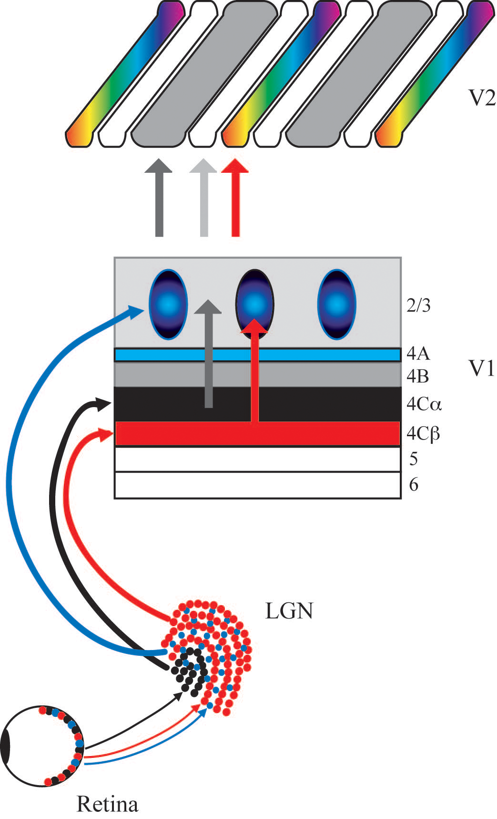
Early visual pathways based on anatomical structure: M, P, K to Dorsal/Ventral?
Grey – V2 thick stripes
(and layer 4B) to MT
=
Movement (Dorsal stream)
Pale – V2 pale stripes
to ?
=
Form (Ventral stream)
Red – V2 thin stripes
to V4
=
Color (Ventral stream)
from Livingstone and Hubel
Notes:
H&L proposed this model for how M/P/K pathways could contribute to dorsal and ventral streams via V2. Probably oversimplified, but could be approximately right?

Slide 3
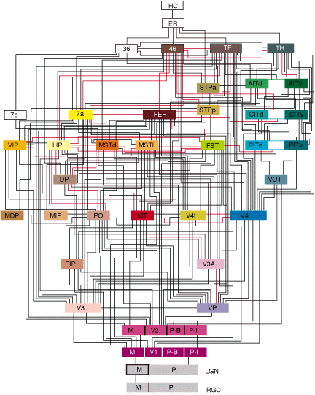
Cortical visual areas –
It’s complicated!
Felleman and Van Essen, 1991
Notes:
Anatomical connectivity is complex!

Slide 4
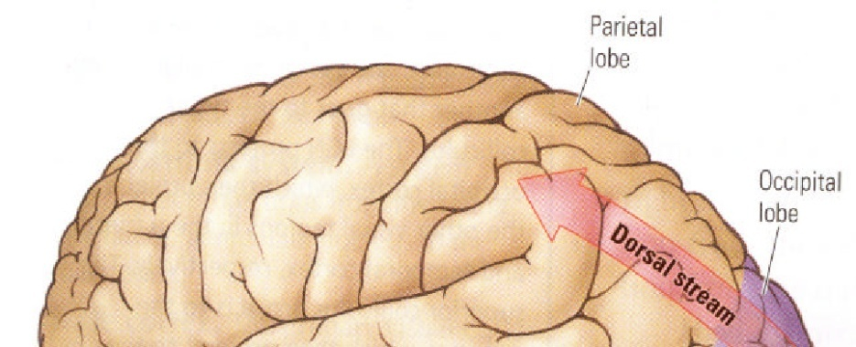
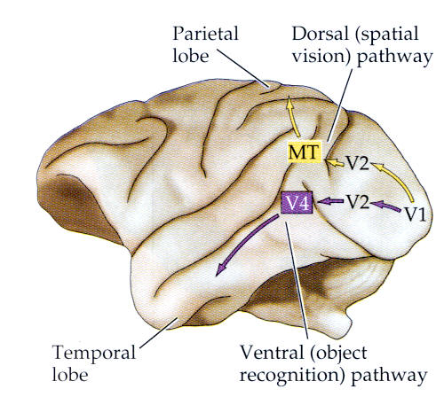
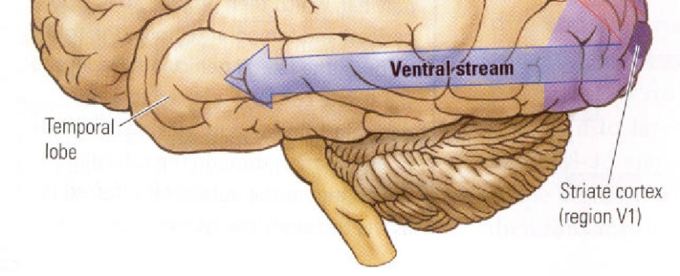
Dorsal and ventral streams
Human
Macaque Monkey
Dorsal Stream – “Where” pathway (spatial vision)
Ventral Stream – “What” pathway (object recognition)
Neuroscience, Third Edition, 2004 Sinauer Associates Inc.
Notes:
Corticocortical projections from V1
Extrastriate areas described as ventral or dorsal stream

Slide 5
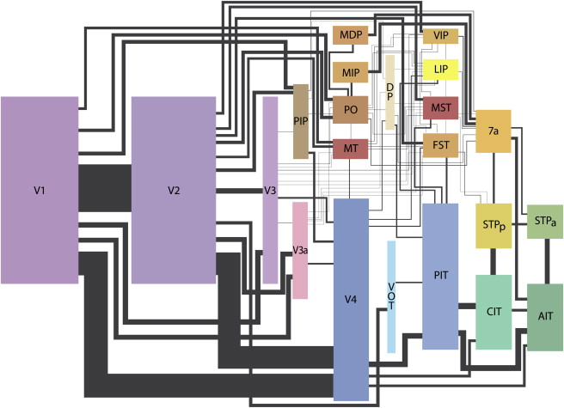
Cortical visual areas – Dorsal and ventral visual areas
Movshon
Notes:
Just visual areas with line thickness approximating anatomical robustness of connections
Dorsal in brown, ventral in blue
V1 mainly targets V2, but also V4 and MT directly
But these types of wiring diagrams are lacking information like “driver” vs “modulator” and of course the types of info being conveyed.

Slide 6
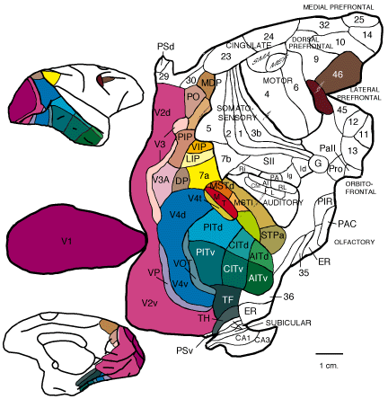
Cortical visual areas – Dorsal and ventral visual areas
Felleman and Van Essen
Notes:
Unfolded visual cortex in macaque
V1 and V2 take up most space, specialized areas are smaller

Slide 7
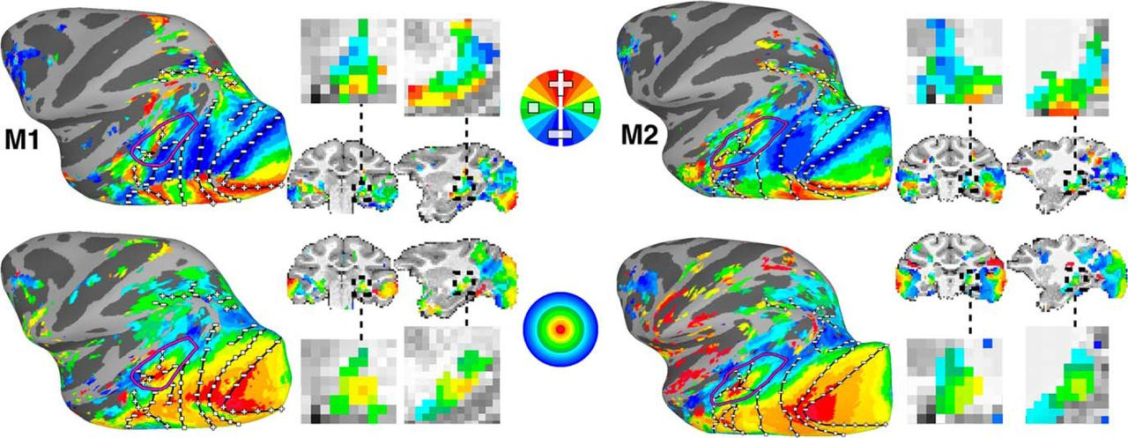
Retinotopy to define visual cortical areas
Arcaro & Livingstone, 2017
Notes:
Unfolded visual cortex in macaque
V1 and V2 take up most space, specialized areas are smaller

Slide 8
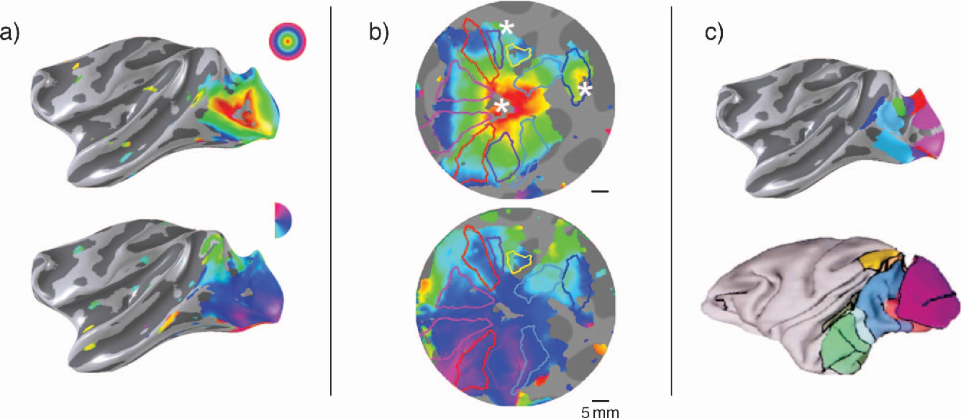
Retinotopic imaging of V1, the unfolding and flattening cortex to obtain maps
Wade et al, 2007
Notes:
Unfolded visual cortex in macaque
V1 and V2 take up most space, specialized areas are smaller

Slide 9
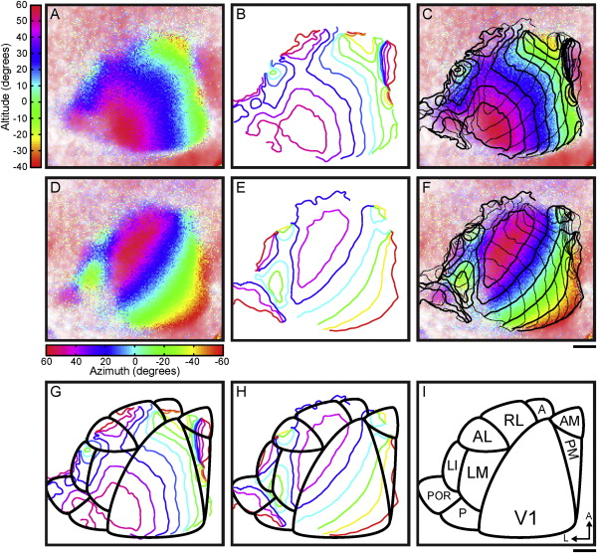
Cortical visual areas in mouse, also defined by retinotopy
Callaway
Notes:
Contrast – visual areas in mouse and retinotopic map
Map suggests only a few “dedicated” visual areas and support idea that in mouse, visual cortex is really multi-sensory cortex

Slide 10
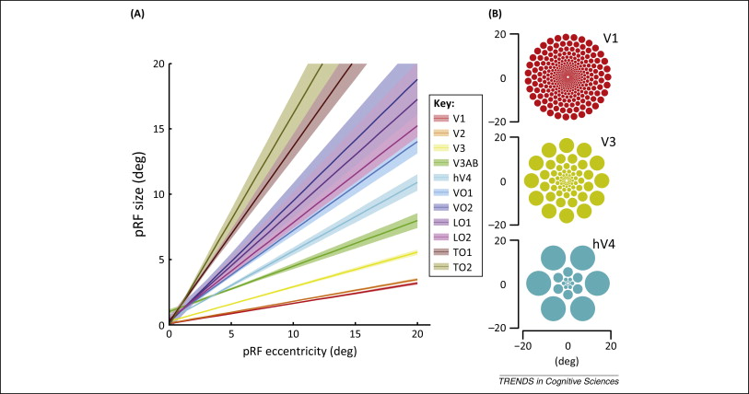
Receptive field sizes scale with eccentricity and along the cortical hierarchy
Wandell & Winawer, 2015
Notes:
Contrast – visual areas in mouse and retinotopic map
Map suggests only a few “dedicated” visual areas and support idea that in mouse, visual cortex is really multi-sensory cortex

Slide 11
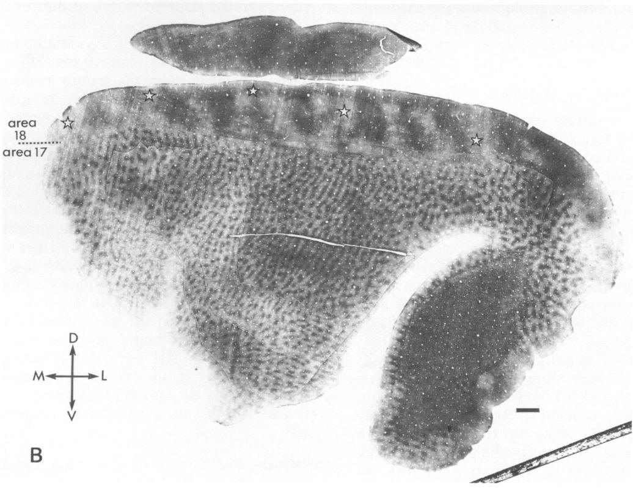
Cytochrome oxidase staining of layer 2/3 in V1 and V2 reveal “blobs” and stripes
Stripes
Blobs
Livingstone and Hubel, 1984
Notes:
We’ve seen examples of functional architecture and domains e.g. blobs and we also know that different layers have different roles (e.g. layer 4 receives LGN input). Do anatomical domains match functional domains? What is special about blobs?
Also CO stripes in V2 shown here.

Slide 12
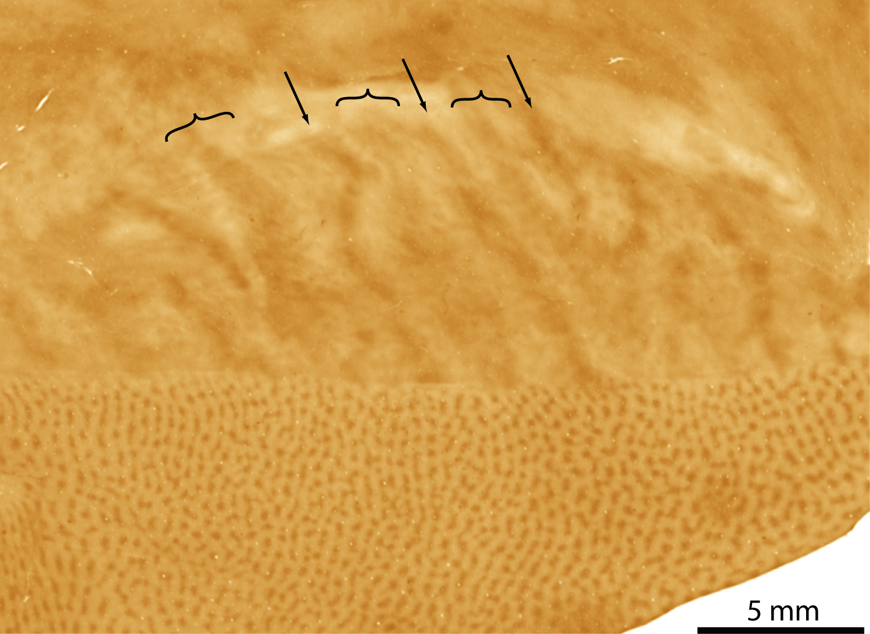
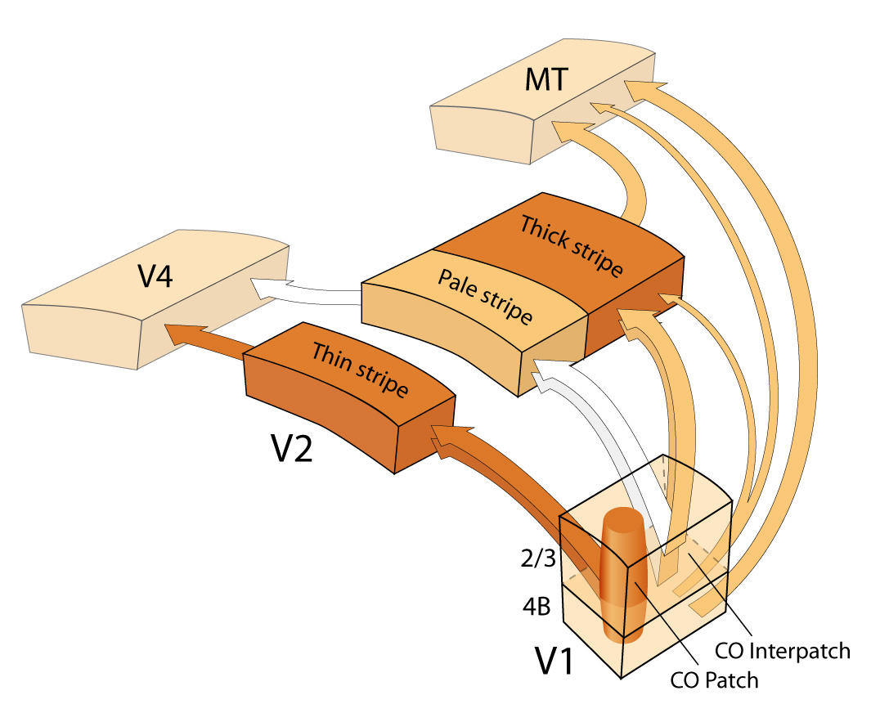
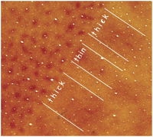
Projections from V1 to V2 and beyond
from Sincich and Horton
Notes:
Data-driven representation of V1 to V2 to V4/MT projections (based on anatomical tracer studies)
Left are blobs and V2 stripes
Right schematic illustrating blobs to thin stripes and interblobs to pale and thick stripes

Slide 13
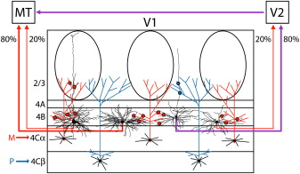
Projections from V1 to V2 and MT
Nassi and Callaway, 2007
Notes:
Some V1 neurons also directly target MT, including stellate and pyramidal neurons in layer 4B (just 1 synapse downstream of magno inputs)
Most of MT direct projections from interblob neurons
Interblob neurons also project to V2 (thick stripes?) then to MT
Less input from blob cells to MT directly or indirectly

Slide 14
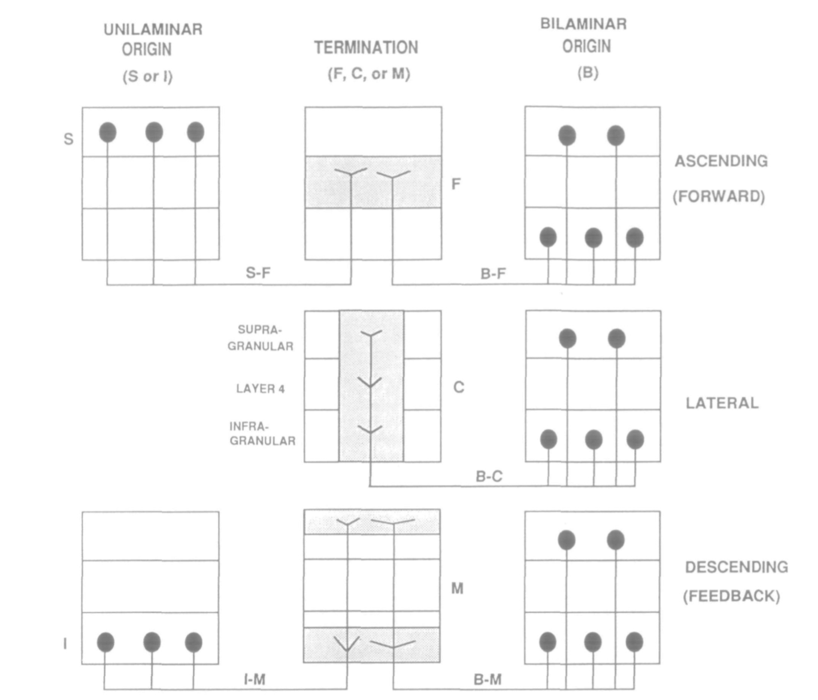
General rules for feedforward and feedback corticocortical connections
Felleman & Van Essen, 1991
Notes:
Some V1 neurons also directly target MT, including stellate and pyramidal neurons in layer 4B (just 1 synapse downstream of magno inputs)
Most of MT direct projections from interblob neurons
Interblob neurons also project to V2 (thick stripes?) then to MT
Less input from blob cells to MT directly or indirectly

Slide 15
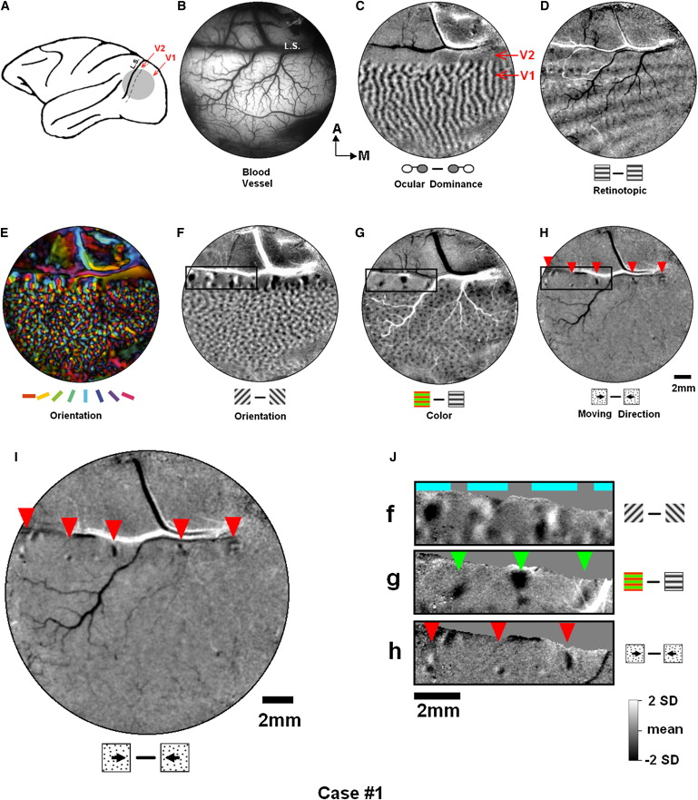
Structural organization of V2
Lu et al, 2010
Notes:
Functional properties of extrastriate cortical neurons: V2
Optical imaging results showing orientation domains, color domains, and motion domains in V2
Note (bottom right) that color and orientation domains in V2 are not overlapping but adjacent to one another (in stripes)

Slide 16
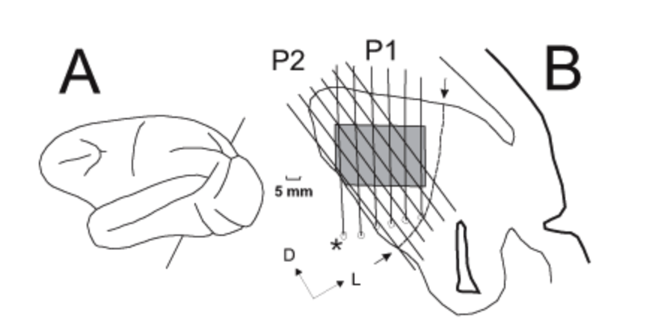
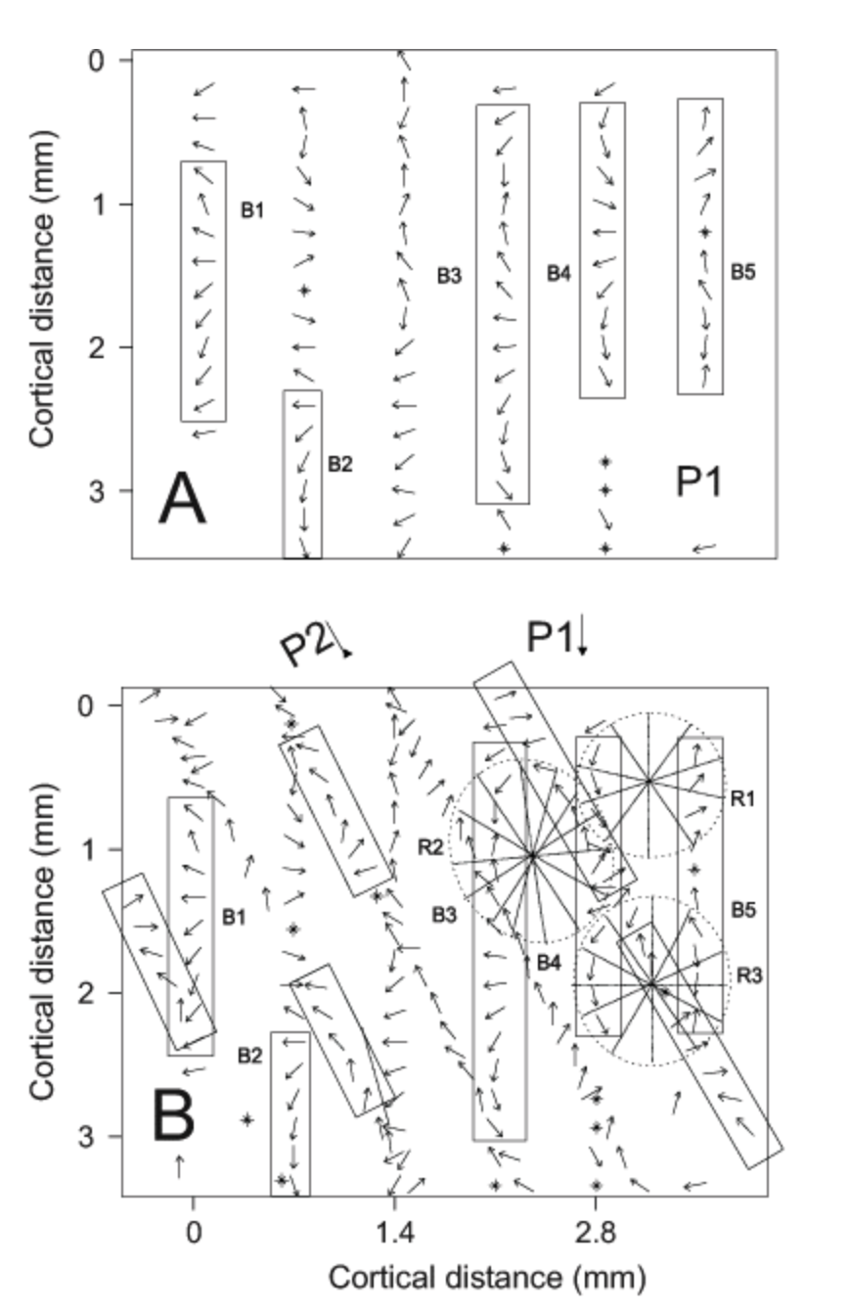
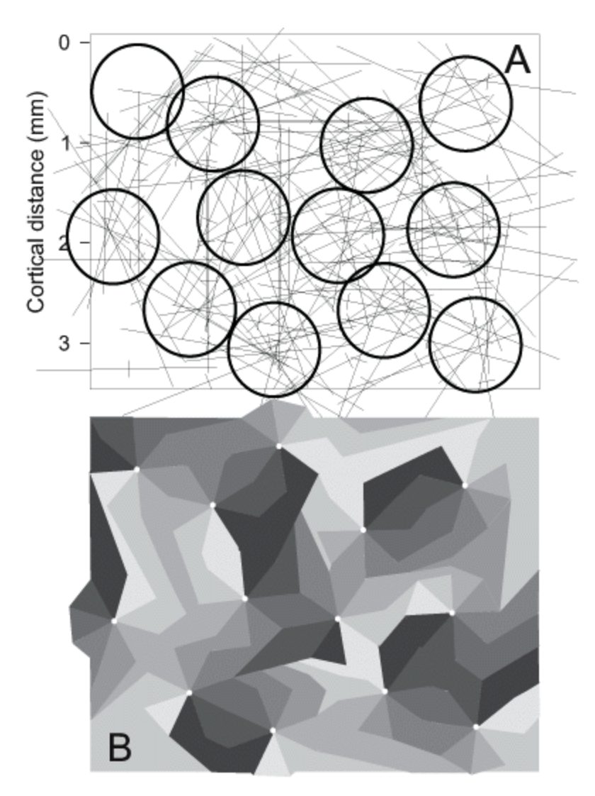
Columns of direction selective neurons in MT
Diogo et al, 2002
Notes:
Interesting physiological transformation from V1 to MT is responsiveness to pattern motion.
Plaid stimulus
V1 neurons follow components and not pattern motion
MT neuron follows pattern motion (matching our perception)

Slide 17
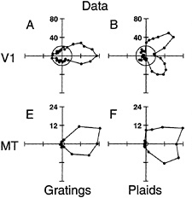
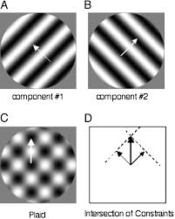
Physiology of MT neurons – whole pattern versus component motion
Movshon
Notes:
Interesting physiological transformation from V1 to MT is responsiveness to pattern motion.
Plaid stimulus
V1 neurons follow components and not pattern motion
MT neuron follows pattern motion (matching our perception)

Slide 18
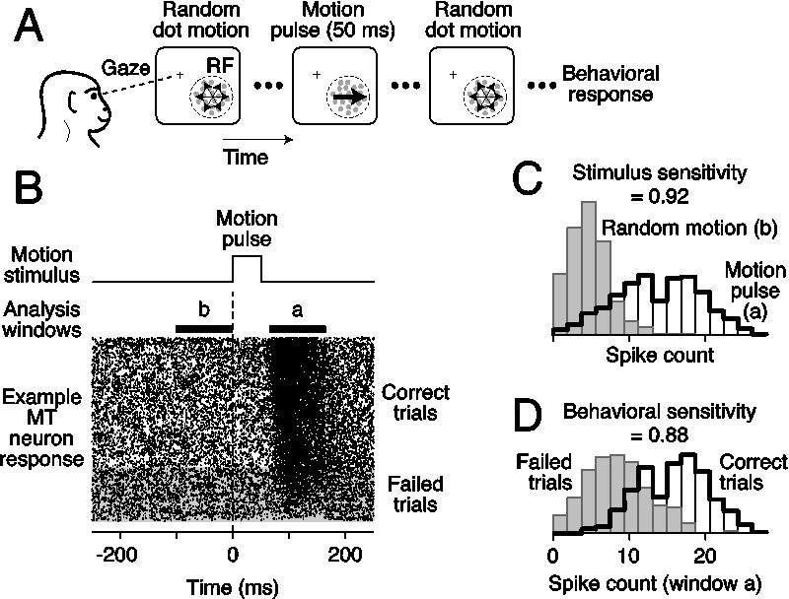
Physiology of MT neurons
Smith et al, 2012
Notes:
MT is a highly motion-sensitive region with direction preference columns.
Random dot motion task
Neurons respond strongly to dot motion (B)
Single-neuron activity in MT correlates with animal’s behavior

Slide 19
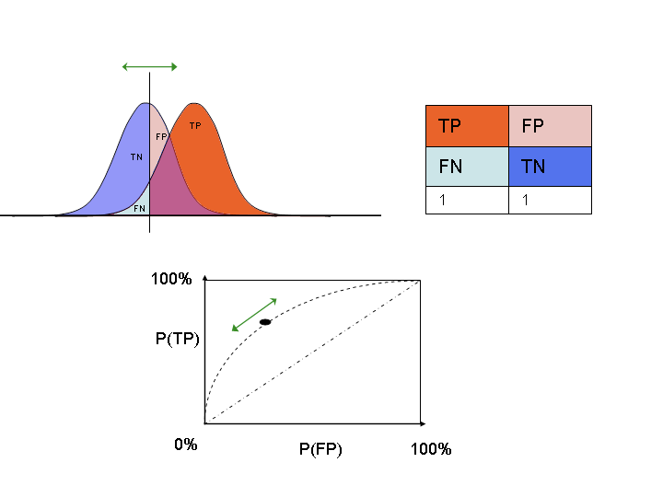
Understanding choice probabilities
Wikipedia

Slide 20
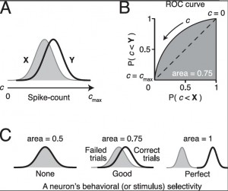
Neuronal activity as a function of behavior (or a predictor of behavior)
Jackson Smith (adapted from Smith et al, 2012)

Slide 21
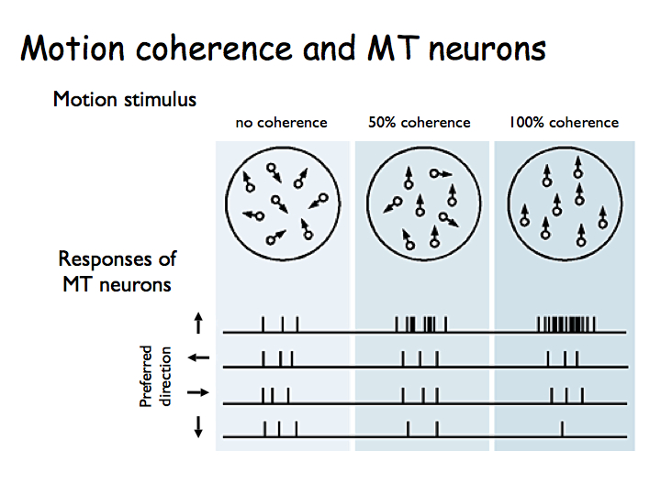
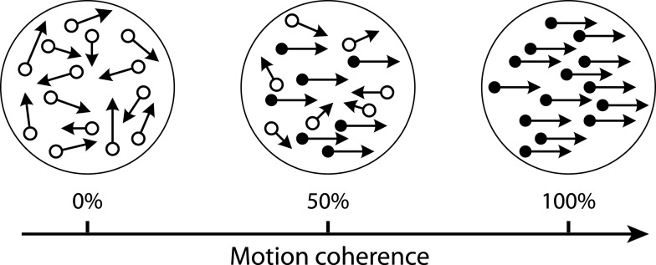
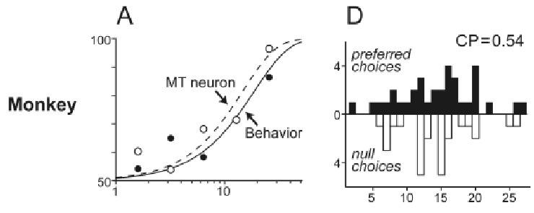
MT neurons motion response and choice probability
CNS.NYU; Mazurek et al, 2003

Slide 22
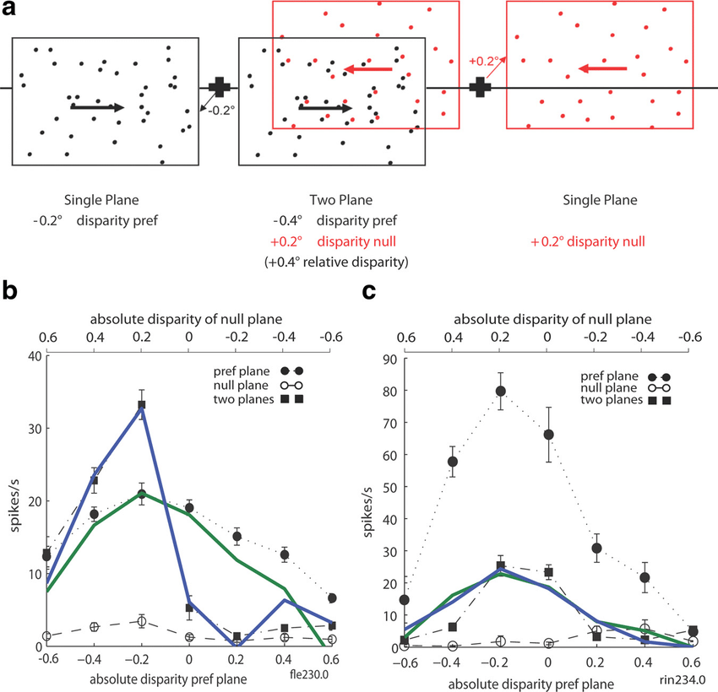
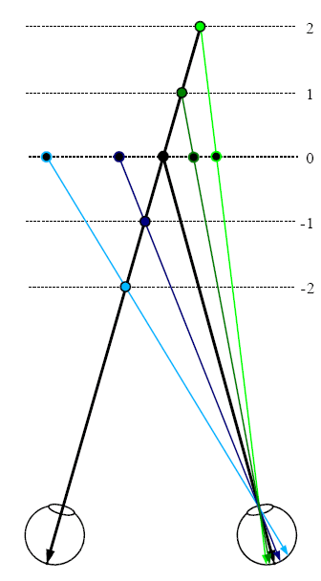
Disparity tuning in MT
Wikipedia; Krug & Parker, 2011

Slide 23
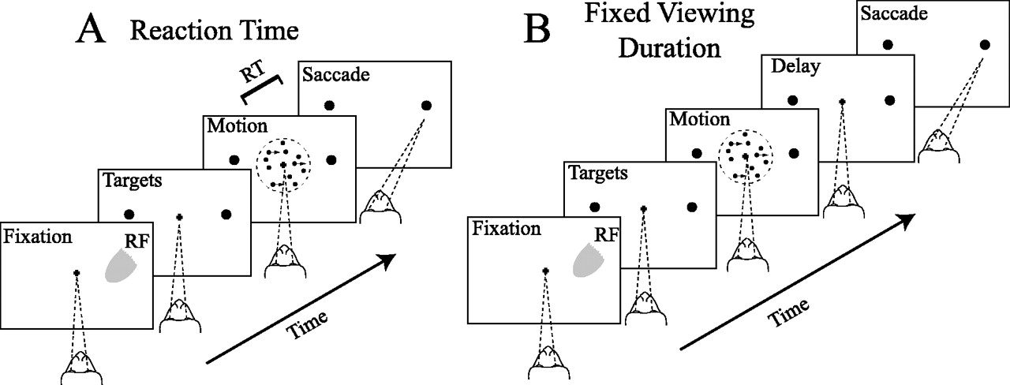
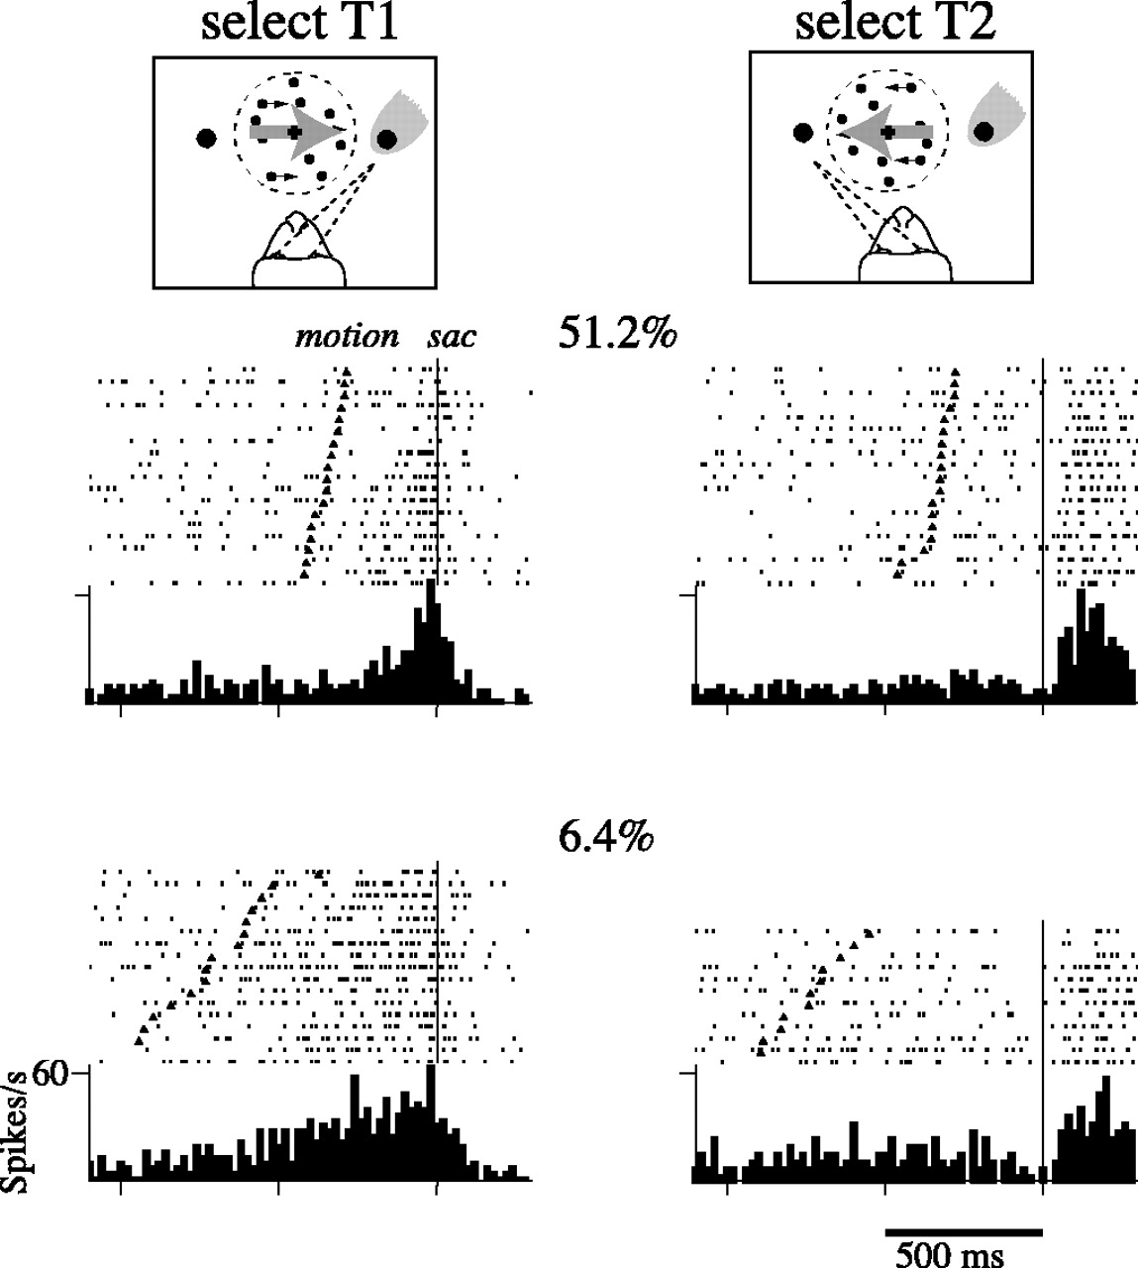
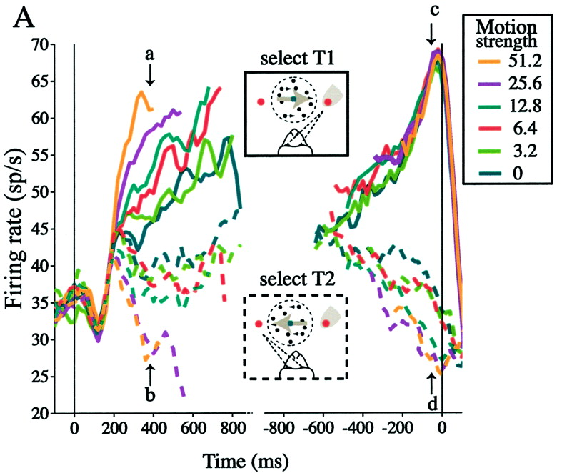
LIP responses to
direction decision
Roitman & Shadlen, 2002

Slide 24
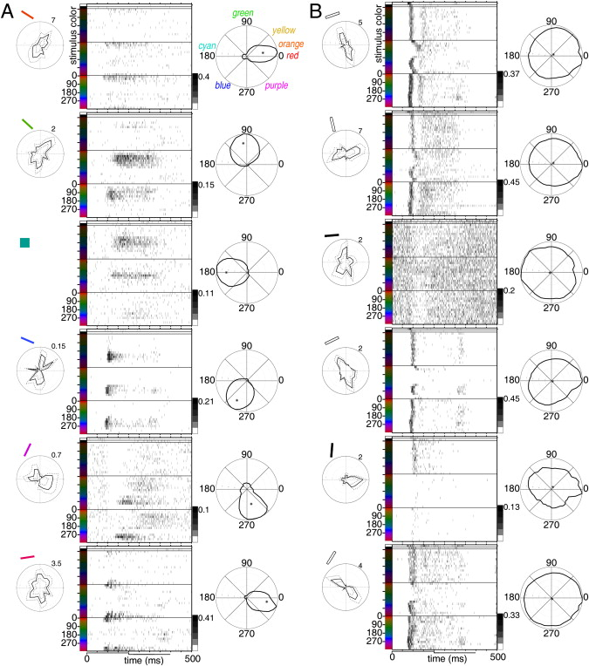
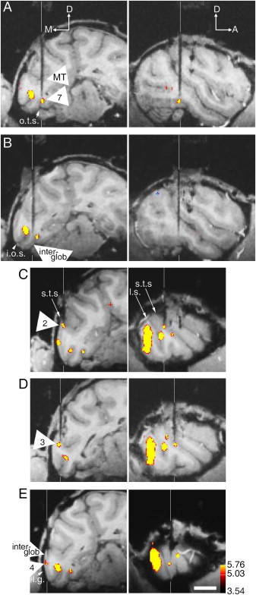
IT cortex responses to specific hues
Conway et al, 2007
Notes:
Clever experiments to identify physiology of extrastriate areas: combining fMRI with single-unit recording
Specific color/hue-selective regions in extrastriate cortex

Slide 25
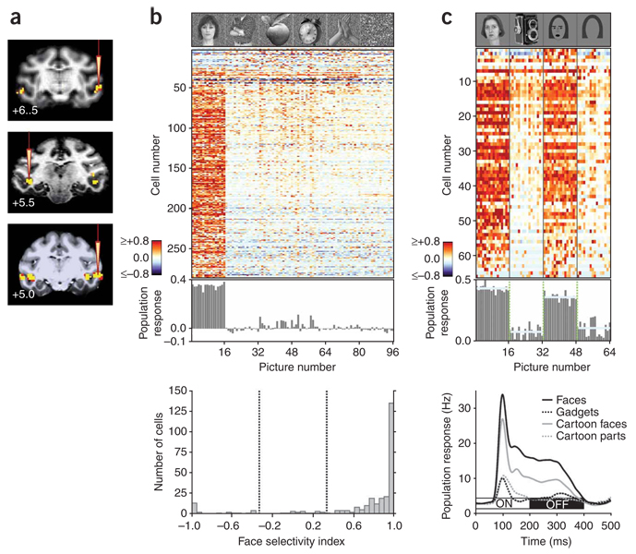
IT cortex responses to faces
Freiwald et al, 2009
Notes:
Face recognition important in primates
Use fMRI and electrophys to identify face-selective regions in primate extrastriate cortex
Neurons specific to facial features – could be cartoon, but had to have eyes, nose and mouth

Slide 26
A prosopagnosic’s view of faces
Chuck Close

Slide 27
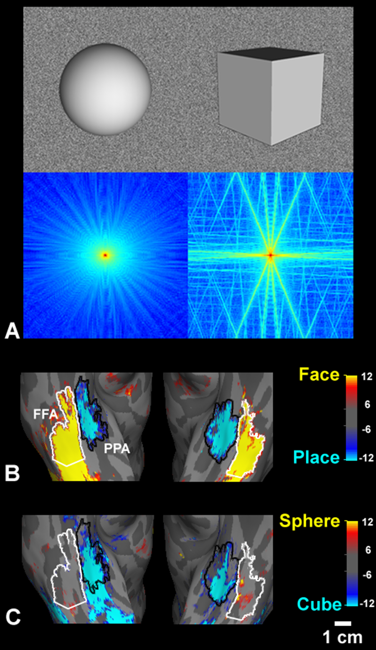
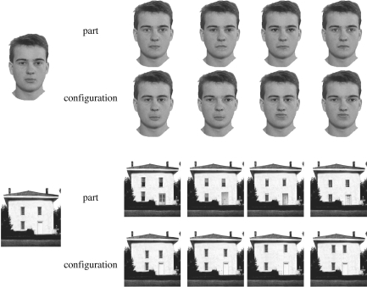
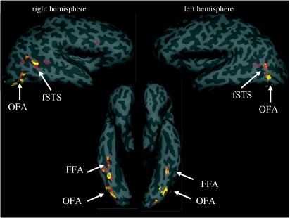
Specific brain areas for faces (and places?) in humans
Kanwisher & Yovel, 2006; Rajimehr et al, 2011

Slide 28
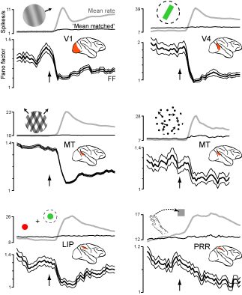
Variance in visual cortical responses to stimuli
Churchland et al, 2010
Notes:
Summary of different stimuli that best activate neurons in different visual areas of monkey
Paper actually shows that variability in response is reduced at response onset, common effect across areas and stimuli

Slide 29
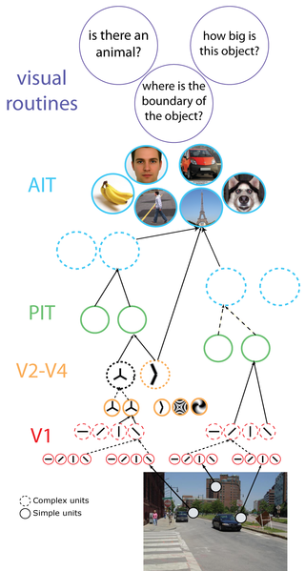
Summary of visual responses
Poggio and Serre
Notes:
Another summary of visual areas and stimuli they encode
V1 = bars
V2/V4 = shapes…

